Slide 1
CHAPTER 14 Quantitative data analysis

Slide 2
Quantification of Data
Quantitative Analysis
The numerical representation of observations for the purpose of describing and explaining the phenomena that those observations reflect.

Slide 3
Coding Quantitative Data
Age
1 = 1
2 = 2
3 = 3
4 = 4
5 = 5
Sex
Male = 1
Female = 2
Political Affiliation
Democrat = 1
Republican = 2
Independent = 3
Region of Country
West = 1
Midwest = 2
South = 3
Northeast = 4

Slide 4
Coding Quantitative Data
Develop Code Categories
Use well-developed coding scheme.
Generate codes from your data.

Slide 5
Coding Quantitative Data
Codebook
A document that lists the assignments of codes to the attributes composing the variables (meanings of codes, and code labels).
Purpose of the Codebook
Primary guide in the coding processes

Slide 6
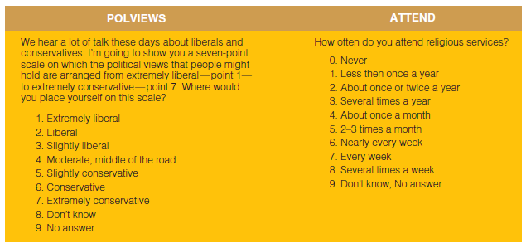
Figure 14-1
Partial Codebook

Slide 7
Abbreviated Variable Name
ATTEND
How often do you attend religious services?
0. Never
1. Less than once a year
2. About once or twice a year
3. Several times a year
4. About once a month
5. 2-3 times a month
6. Nearly every week
7. Every week
8. Several times a week
9. Don’t know, No answer
Definition of the Variable
Numerical Label
Variable Attributes

Slide 8
Coding Quantitative Data
Continuous Variable
A variable whose attributes form a steady progression
Interval variables: age, income
Discrete/Categorical Variable
A variable whose attributes are separate from one another
Nominal or ordinal variables: gender, political affiliation, socio-economic status.

Slide 9
Coding Quantitative Data
Considerations
“Collapsing” Response Categories
Handling “Don’t Knows”

Slide 10
Coding Quantitative Data
Data entry in widely-usable format
Excel (.csv)
Analysis software
SPSS
STATA
R

Slide 11
Univariate Statistics
Univariate Statistics
The description of a single variable
frequencies
measures of central tendency
measures of dispersion

Slide 12
Univariate Statistics
Frequency Distributions
The number of times the various attributes of a variable are observed in a sample.
Usually in percentage

Slide 13
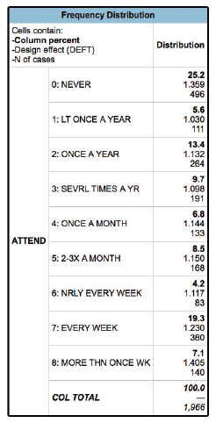
Figure 14-3
Attendance at Religious Services, 2012

Slide 14
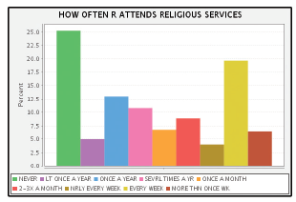
Figure 14-4
Bar Chart of GSS ATTEND, 2012

Slide 15
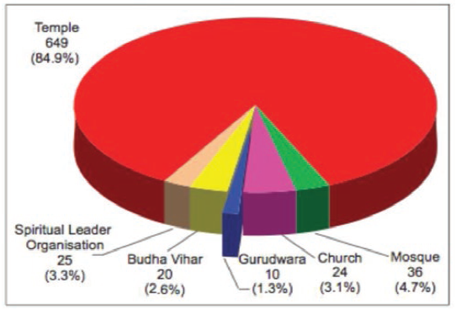
Figure 14-5
Pie Chart showing Number and Percentage of Religious Institutions by Type

Slide 16
Example: Number of Students in Class using Laptops/Tablets
Variable:
Student Laptop Use
Information:
Student Total: 39
With Laptops:
Without Laptops:
Variable Type?
Frequency Distribution (in percentage)?

Slide 17
Univariate Statistics
Measures of Central Tendency
Univariate ways of describing the data
Mean
Median
Mode

Slide 18
Univariate Statistics
Mode
the most frequently observed value or attribute. Can be used for all variable types: nominal, ordinal, and interval.
Median
the value of the “middle” case in a rank-ordered set of observations. Should only be used for two variable types: ordinal, and interval.
Mean
computed by summing the values of several observations and dividing by the number of observations. Should only be used for interval variables

Slide 19
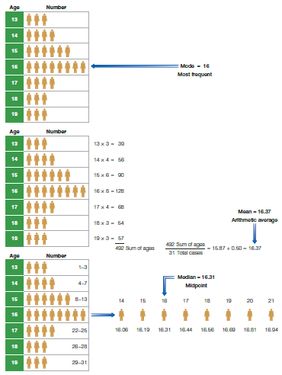
Figure 14-6
Three “Averages” or Measures of Central Tendency

Slide 20
Example: Number of Students in Class using Laptops/Tablets
Variable:
Student Laptop Use
Information:
Student Total: 39
With Laptops:
Without Laptops:
Measure of Central Tendency?

Slide 21
Univariate Statistics
Dispersion
The distribution/spread of values around a measure of central tendency.
Only used for interval level variables
Range
Standard Deviation

Slide 22
Univariate Statistics
Range:
distance between highest and lowest value
Standard Deviation:
A measure of dispersion around the mean, calculated so that approximately 68 percent of the cases will lie within plus or minus one standard deviation from the mean, 95 percent within two, and 99.9 percent within three standard deviations.

Slide 23
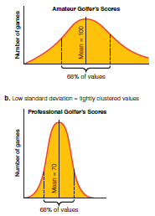
Figure 14-7
High and Low Standard Deviations

Slide 24
Bivariate Statistics
Bivariate Statistics
The analysis of two variables simultaneously, for the purpose of determining an empirical relationship between them.

Slide 25
Bivariate Statistics
Constructing a Bivariate Table
Determine logical direction of relationship (independent variable and dependent variable).

Slide 26
Bivariate Statistics
 | Dependent Variable
Independent Variable | Discrete/Categorical | Continuous
Discrete/Categorical | Chi-Square | T-Test or ANOVA
Continuous | N/A | Correlation

Slide 27
Bivariate Statistics
Example: Gender and Attitude toward Sexual Equality
The cases are divided into men and women.
Each gender subgrouping is described in terms of approval or disapproval of sexual equality.
Men and women are compared in terms of the percentages approving of sexual equality.

Slide 28
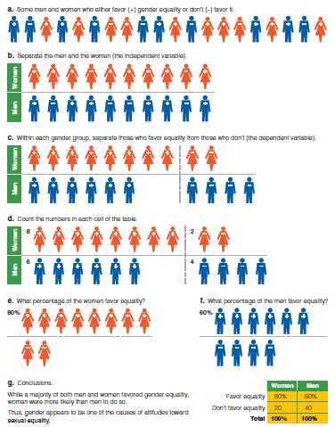
Figure 14-8
Percentaging a Table

Slide 29
Bivariate Tables
Guidelines for Presentation of Tables
A table should have a heading or title that describes what is contained in the table.
Original content should be clearly presented.
The attributes of each variable should be clearly indicated.
The base on which percentage are computed should be indicated.
Missing data should be indicated in the table.

Slide 30
Multivariate Statistics
Multivariate Statistics
The analysis of the simultaneous relationships among several variables.
Regressions (Multiple/Linear/OLS, Binomial Logistic, Multinomial Logistic, Poisson, Negative Binomial, Event History/Survival Analysis, Time-Series)

Slide 31
Multivariate Statistics
Multivariate techniques allow the researcher to measure multiple variables at the same time
Can be used to better explain why women make less than men in the job market

Slide 32
Chapter Summary
Provide an example illustrating the quantification of data.
Identify and discuss the several aspects of univariate analysis.
Explain what is gained when subgroup comparisons are used instead of univariate analyses.
Describe and illustrate the difference between subgroup comparisons and bivariate analyses.
List and explain the added advantages of multivariate analysis over bivariate analysis.
Outline an example of sociological diagnostics and how it might be used in relation to social causes.
Define ways in which ethical issues may arise in connection with quantitative analyses.

